Slide 1
HCI 201 Multimedia and the www
Multimedia & The World Wide Web
winny

Slide 2
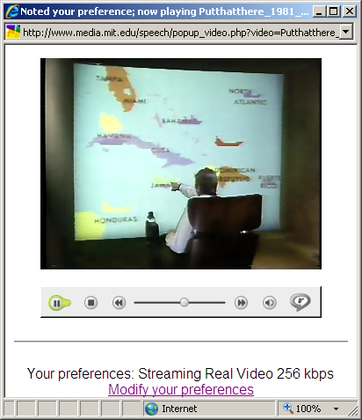
Multimedia Interfaces
Multimedia interface combines different sorts of media modalities to achieve more natural and more efficient human computer communication.
  Speech, audio, touch, video input (patterns, posture, gesture) etc.
“Put that there” is an example multimedia HCI that combines speech, gestures and graphics.
Put that there, MIT 1981
http://www.media.mit.edu/speech/sig_videos.html
CS335 Principles of Multimedia Systems

Slide 3
Early and Late Integration
Mode 1
Features
Classification
Output
Mode 2
Early integration
Mode 1
Classification
Features
Output
Mode 2
Classification
Late integration
CS335 Principles of Multimedia Systems

Slide 4
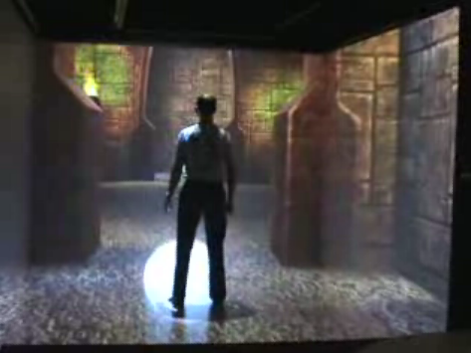
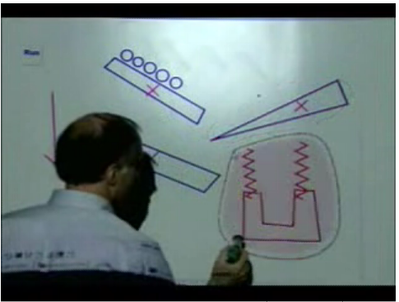
Advantages of Multimedia Interface
More alternative methods.
The flexibility of combining different schemes.
More efficient for specific tasks.
Greater precision of information.
Help handicapped people to use computers.
Pen gesture interface
Virtual Reality
http://www.youtube.com/watch?v=d7eGypGOlOc&feature=related
http://www.youtube.com/watch?v=Gnq-8iaOcXk
CS335 Principles of Multimedia Systems

Slide 5
What is important in web design?
HCI 201 Multimedia and the www
Color
Layout
Content
Text – Important to know that the font you intend may not be fonts in user’s browsers.
winny

Slide 6
HCI 201 Multimedia and the www
What is COLOR?
Color is commonly referred to as a property of things
Color, though, exists only in the brain. It is a neural process, triggered by retinal responses to wavelengths of light.
winny

Slide 7
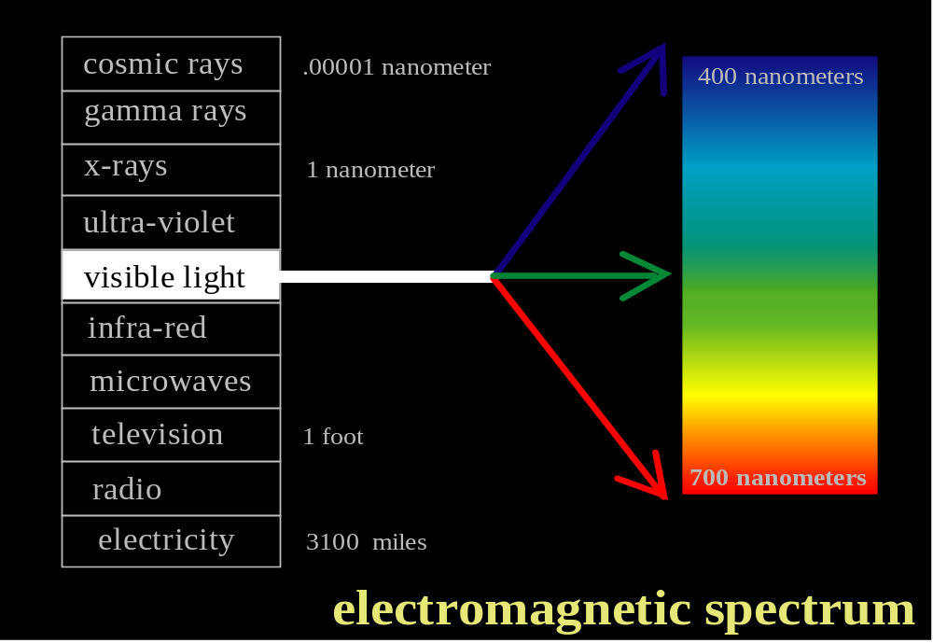
HCI 201 Multimedia and the www
COLOR
ultra-violet
visible light
winny

Slide 8
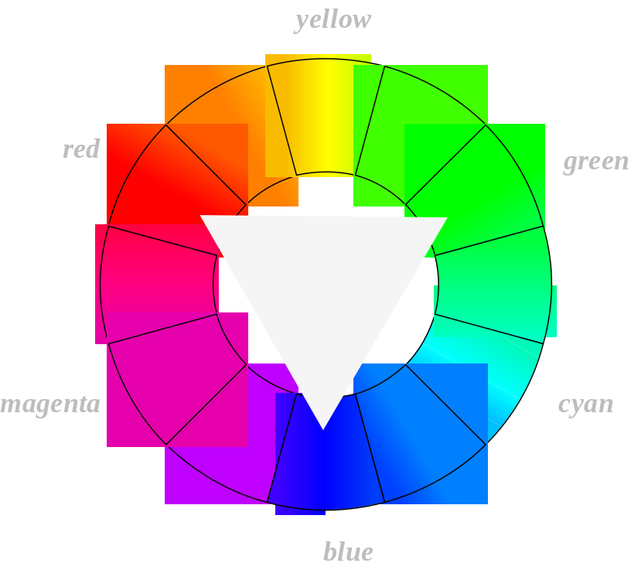
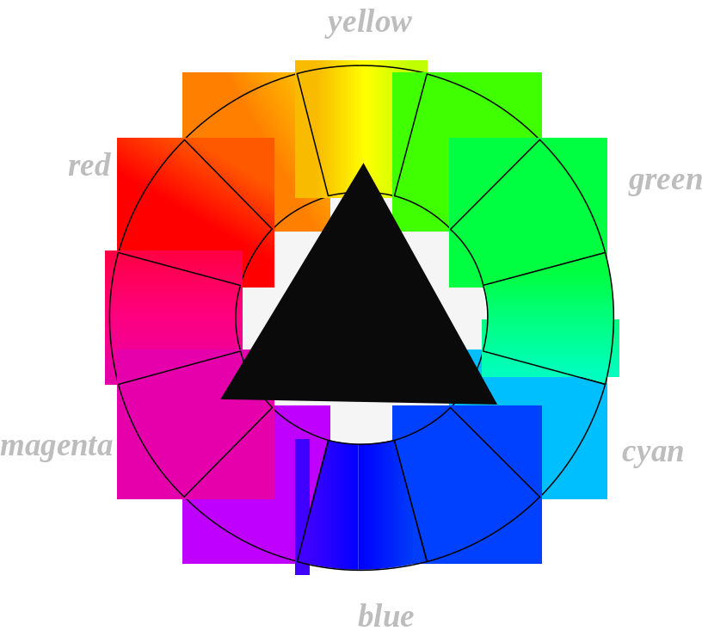

HCI 201 Multimedia and the www
COLOR
additive
subtractive
winny

Slide 9
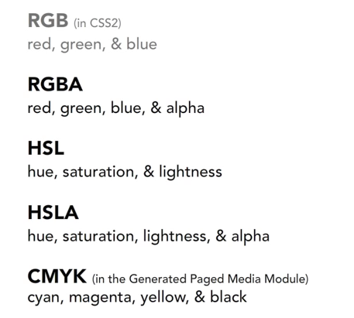
HCI 201 Multimedia and the www
COLOR
winny

Slide 10
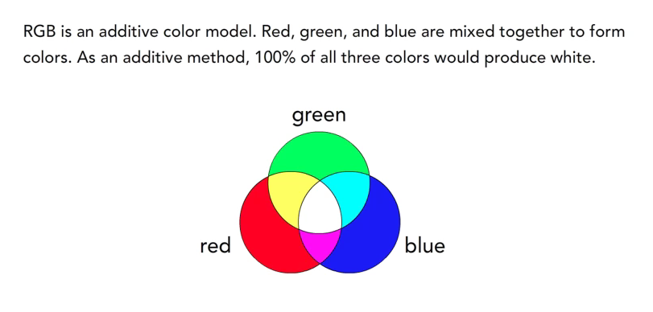
HCI 201 Multimedia and the www
COLOR
winny

Slide 11
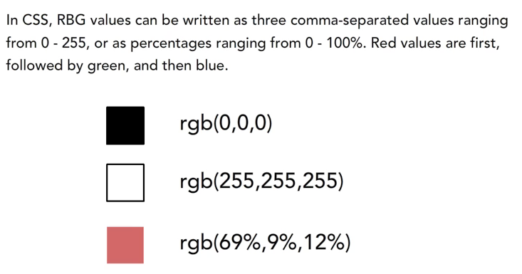
HCI 201 Multimedia and the www
COLOR
winny

Slide 12
HCI 201 Multimedia and the www
COLOR
HUE: the dimension of color determined by the light wave grouping of the color.
SATURATION: the amount of hue in a color. The saturation of a color decreases as it moves to black, white or gray.
VALUE: the lightness or darkness of a color, measured as a level of gray.
winny

Slide 13
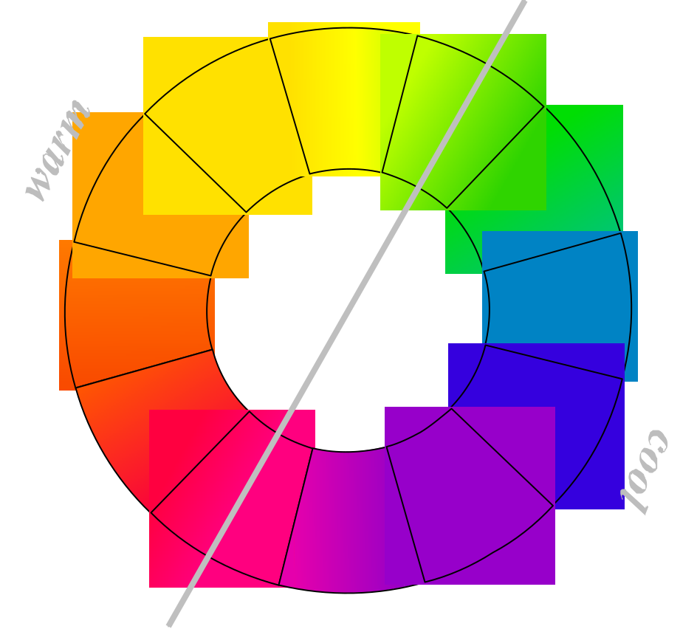
HCI 201 Multimedia and the www
HUE Temperature
winny

Slide 14
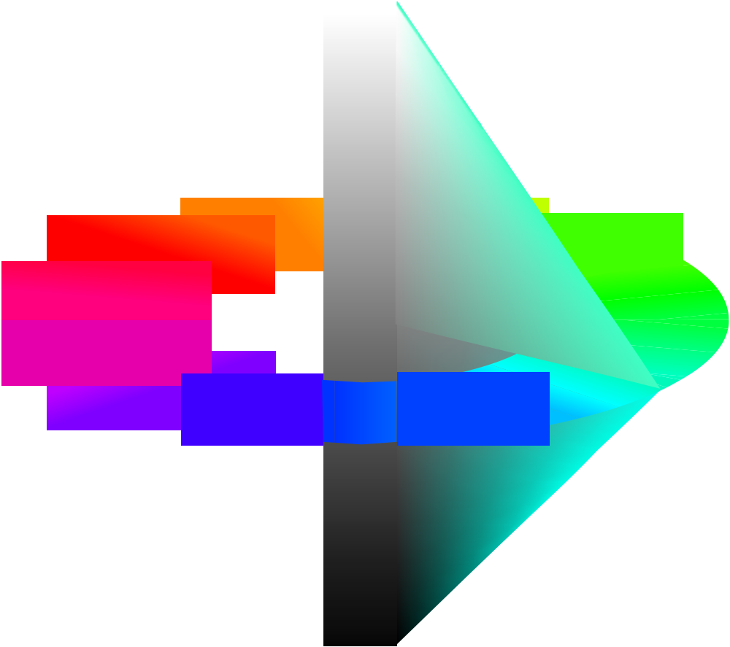
HCI 201 Multimedia and the www
COLOR Space
LIGHTNESS
SATURATION
HUE
winny

Slide 15
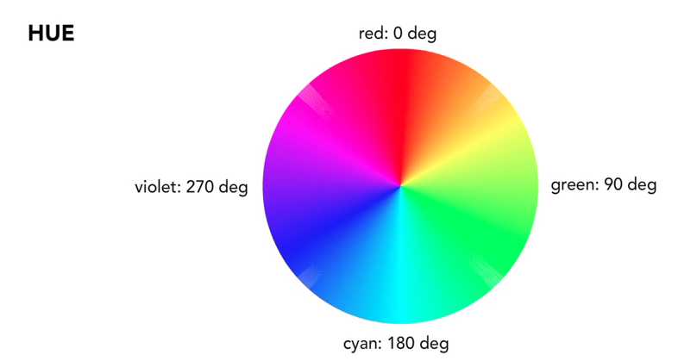
HCI 201 Multimedia and the www
COLOR
winny

Slide 16
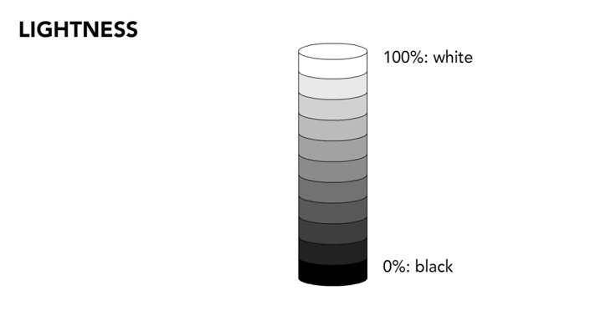
HCI 201 Multimedia and the www
COLOR
winny

Slide 17
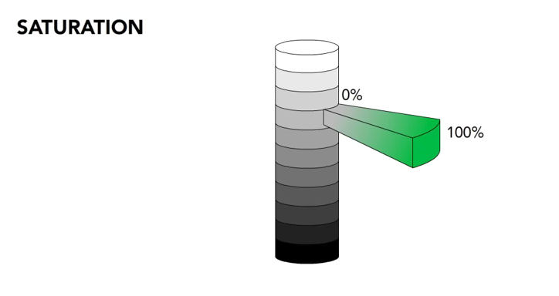
HCI 201 Multimedia and the www
COLOR
winny

Slide 18
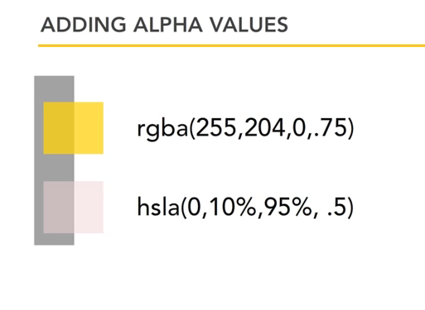
HCI 201 Multimedia and the www
COLOR
winny

Slide 19

HCI 201 Multimedia and the www
COLOR
winny

Slide 20
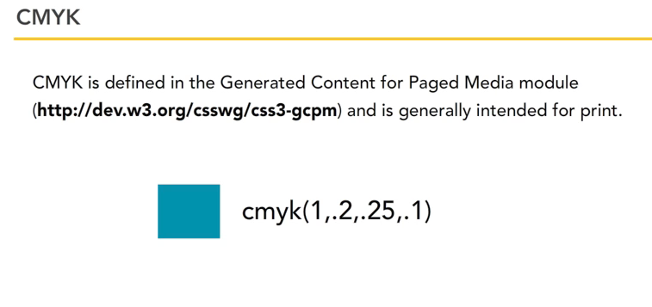
HCI 201 Multimedia and the www
COLOR
winny

Slide 21
Colors in web design
HCI 201 Multimedia and the www
Color is a powerful component in web design.
It defines a web site's environment and influences the mood and emotion.
Plan the use of colors carefully.
No matter which colors are chosen, colors must be used consistently throughout the design. If used that way, colors create visual boundaries that give a web site a feeling of place.
winny

Slide 22
Choose Colors
HCI 201 Multimedia and the www
Color makes you feel, so select the color support your message
Understand the basics of color theory.
understand how colors complement and interact with each other.
Use a limited palette
Readability
winny

Slide 23
Color Associations
HCI 201 Multimedia and the www
Red
Blue
Green
Yellow
Orange
Black
winny

Slide 24
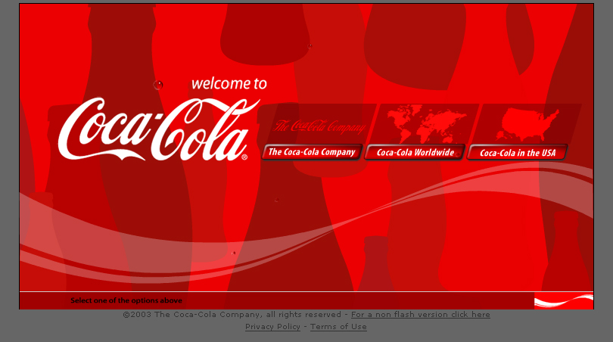
HCI 201 Multimedia and the www
winny

Slide 25
Red
HCI 201 Multimedia and the www
Red is the color of fire and blood
It is associated with energy, war, danger, strength, power, determination as well as passion, desire, and love
Red is a very emotionally intense color.
It enhances human metabolism, increases respiration rate, and raises blood pressure.
It has very high visibility, which is why stop signs, stoplights, and fire equipment are usually painted red.
winny

Slide 26
Red
HCI 201 Multimedia and the www
Red brings text and images to the foreground
Use it as an accent color to stimulate people to make quick decisions
it is a perfect color for 'Buy Now' or 'Click Here' buttons on Internet banners and websites.
Light red represents joy, sexuality, passion, sensitivity, and love
winny

Slide 27
Red
HCI 201 Multimedia and the www
Pink
  signifies romance, love, and friendship. It denotes feminine qualities and passiveness
Dark red
  is associated with vigor, willpower, rage, anger, leadership, courage, longing, malice, and wrath
Brown
  suggests stability and denotes masculine qualities
Reddish-brown
  is associated with harvest and fall
winny

Slide 28
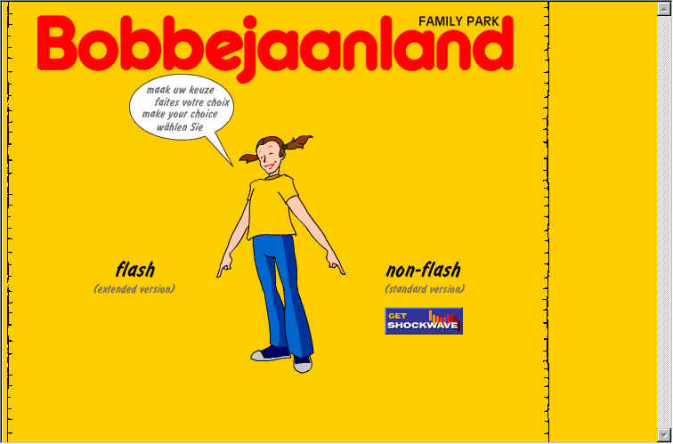
HCI 201 Multimedia and the www
winny

Slide 29
Yellow
HCI 201 Multimedia and the www
Yellow is the color of sunshine. It's associated with joy, happiness, intellect, and energy
Yellow produces a warming effect, arouses cheerfulness, stimulates mental activity, and generates muscle energy
Bright, pure yellow is an attention getter, which is the reason taxi,cabs are painted this color
winny

Slide 30
Yellow
HCI 201 Multimedia and the www
When overused, yellow may have a disturbing effect; it is known that babies cry more in yellow rooms
Yellow is seen before other colors when placed against black; this combination is often used to issue a warning
winny

Slide 31
Yellow
HCI 201 Multimedia and the www
Dull (dingy) yellow
  represents caution, decay, sickness, and jealousy
Light yellow
  is associated with intellect, freshness, and joy
winny

Slide 32
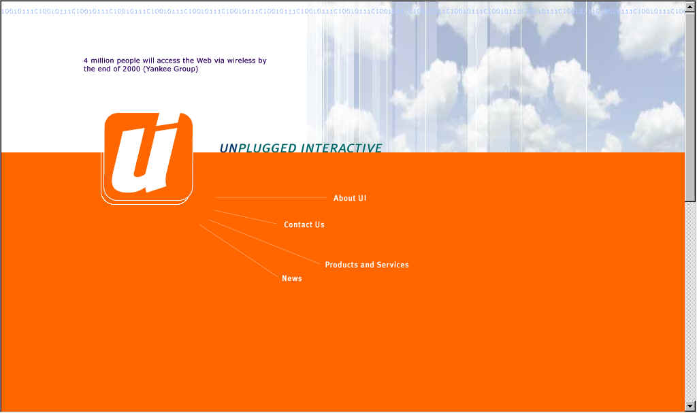
HCI 201 Multimedia and the www
winny

Slide 33
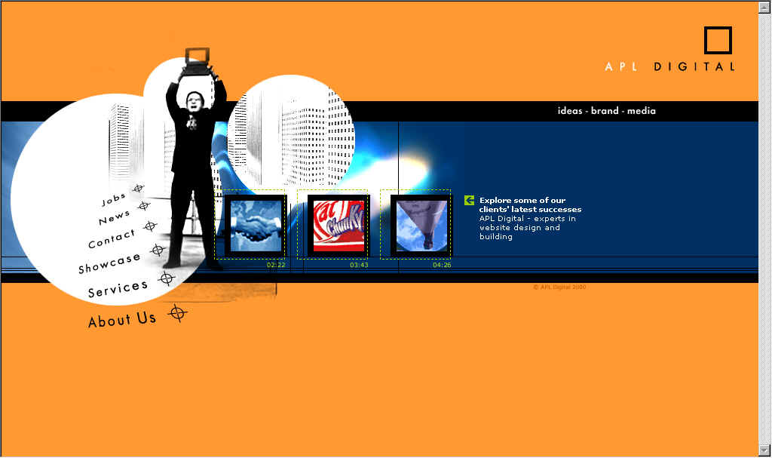
HCI 201 Multimedia and the www
winny

Slide 34
Orange
HCI 201 Multimedia and the www
Orange represents enthusiasm, fascination, happiness, creativity, determination, attraction, success, encouragement, and stimulation
To the human eye, orange is a very hot color, so it gives the sensation of heat
winny

Slide 35
Orange
HCI 201 Multimedia and the www
Orange increases oxygen supply to the brain, produces an invigorating effect, and stimulates mental activity. It is highly accepted among young people. As a citrus color, orange is associated with healthy food and stimulates appetite.
Orange is the color of fall and harvest
Orange has very high visibility, so you can use it to catch attention and highlight the most important elements of your design. Orange is very effective for promoting food products and toys
winny

Slide 36
Orange
HCI 201 Multimedia and the www
Dark orange
  can mean deceit and distrust
Red-orange
  corresponds to desire, sexual passion, pleasure, domination, aggression, and thirst for action
Gold
  evokes the feeling of prestige. The meaning of gold is illumination, wisdom, and wealth. Gold often symbolizes high quality
winny

Slide 37
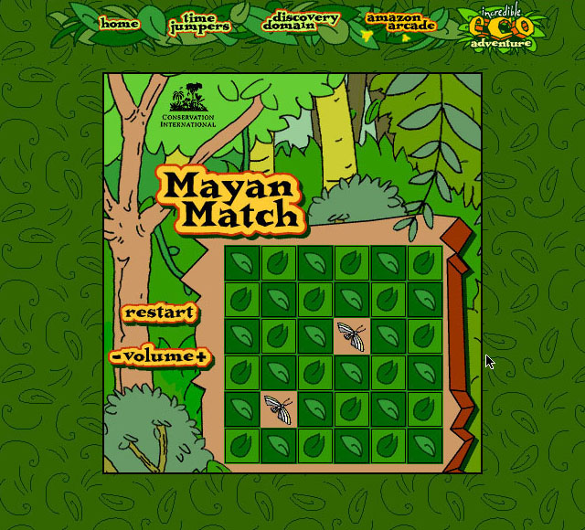
HCI 201 Multimedia and the www
winny

Slide 38
Green
HCI 201 Multimedia and the www
Example
Green is the color of nature. It symbolizes growth, harmony, freshness, and fertility. Green has strong emotional correspondence with safety
Green has great healing power. It is the most restful color for the human eye
Green suggests stability and endurance. Sometimes green denotes lack of experience
winny

Slide 39
Green
HCI 201 Multimedia and the www
Use green to indicate safety when advertising drugs and medical products
Green is directly related to nature, so you can use it to promote ‘green’ products
Dull, darker green is commonly associated with money, the financial world, banking, and Wall Street
http://www.greenpeace.org/international_en/
winny

Slide 40
Green
HCI 201 Multimedia and the www
Dark green
  is associated with ambition, greed, and jealousy
Yellow-green
  can indicate sickness, cowardice, discord, and jealousy
Aqua
  is associated with emotional healing and protection
Olive green
  is the traditional color of peace
winny

Slide 41
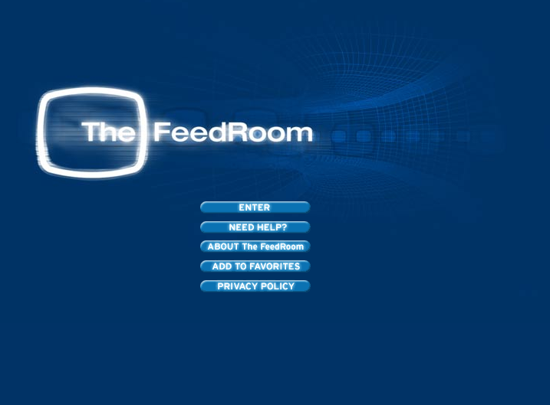
HCI 201 Multimedia and the www
winny

Slide 42
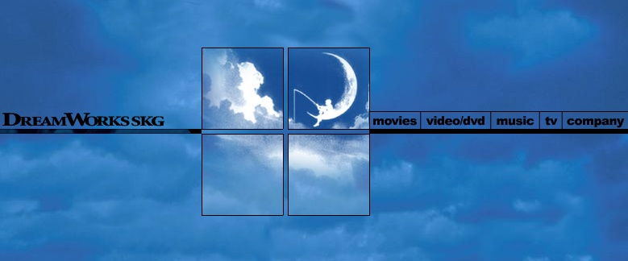
HCI 201 Multimedia and the www
winny

Slide 43
Blue
HCI 201 Multimedia and the www
Blue is often associated with depth and stability.
It symbolizes trust, loyalty, wisdom, confidence, intelligence, faith, truth, and heaven
Blue is considered beneficial to the mind and body. It slows human metabolism and produces a calming effect.
Blue is strongly associated with tranquility and calmness
http://www.united.com/
winny

Slide 44
Blue
HCI 201 Multimedia and the www
You can use blue to promote products and services related to cleanliness (water purification filters, cleaning liquids, vodka), air and sky (airlines, airports, air conditioners), water and sea (sea voyages, mineral water)
As opposed to emotionally warm colors like red, orange, and yellow; blue is linked to consciousness and intellect . Use blue to suggest precision when promoting high-tech products
winny

Slide 45
Blue
HCI 201 Multimedia and the www
Blue is a masculine color; according to studies, it is highly accepted among males. Dark blue is associated with depth, expertise, and stability;
it is a preferred color for corporate America
Avoid using blue when promoting food and cooking, because blue suppresses appetite.
When used together with warm colors like yellow or red, blue can create high-impact, vibrant designs; for example, blue-yellow-red is a perfect color scheme for a superhero
winny

Slide 46
Blue
HCI 201 Multimedia and the www
Light blue
  is associated with health, healing, tranquility, understanding, and softness
Dark blue
  represents knowledge, power, integrity, and seriousness
winny

Slide 47
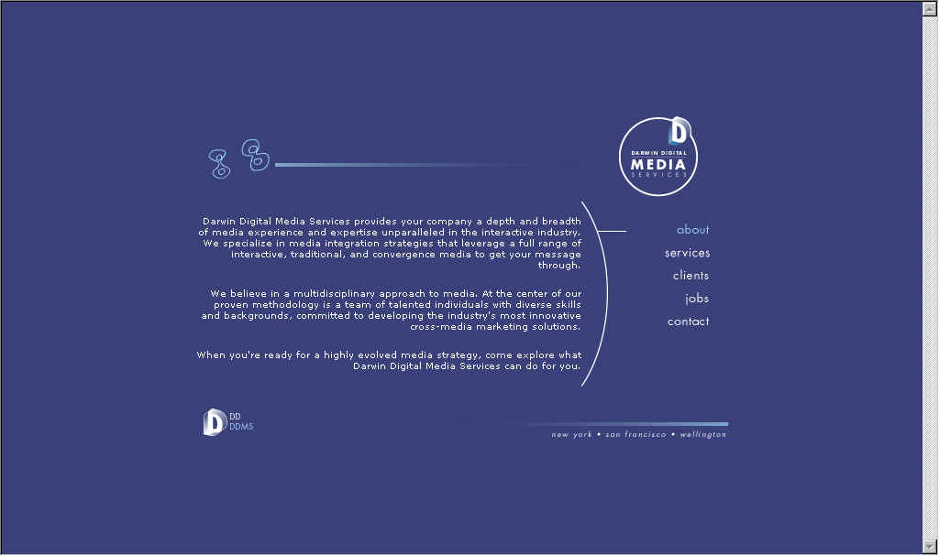
HCI 201 Multimedia and the www
winny

Slide 48
Purple
HCI 201 Multimedia and the www
Purple combines the stability of blue and the energy of red. Purple is associated with royalty
It symbolizes power, nobility, luxury, and ambition. It conveys wealth and extravagance
Purple is associated with wisdom, dignity, independence, creativity, mystery, and magic
http://www.royal.gov.uk/output/Page1.asp
winny

Slide 49
Purple
HCI 201 Multimedia and the www
According to surveys, almost 75 percent of pre-adolescent children prefer purple to all other colors.
Purple is a very rare color in nature; some people consider it to be artificial
Light purple is a good choice for a feminine design. You can use bright purple when promoting children's products
winny

Slide 50
Purple
HCI 201 Multimedia and the www
Light purple
  evokes romantic and nostalgic feelings
Dark purple
  evokes gloom and sad feelings. It can cause frustration
winny

Slide 51
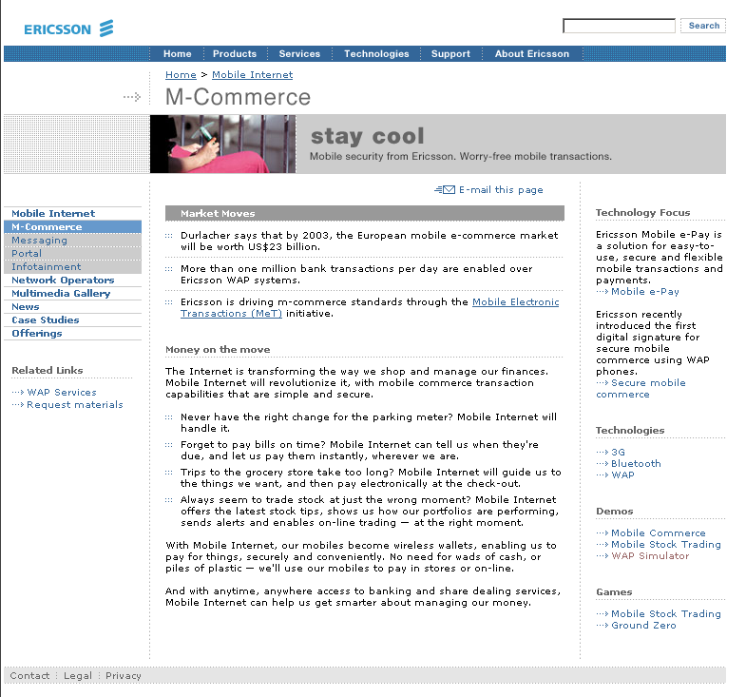
HCI 201 Multimedia and the www
winny

Slide 52
White
HCI 201 Multimedia and the www
White is associated with light, goodness, innocence, purity, and virginity
It is considered to be the color of perfection.
White means safety, purity, and cleanliness.
You can use white to suggest simplicity in high-tech products
White is an appropriate color for charitable organizations; angels are usually imagined wearing white clothes
winny

Slide 53

HCI 201 Multimedia and the www
winny

Slide 54
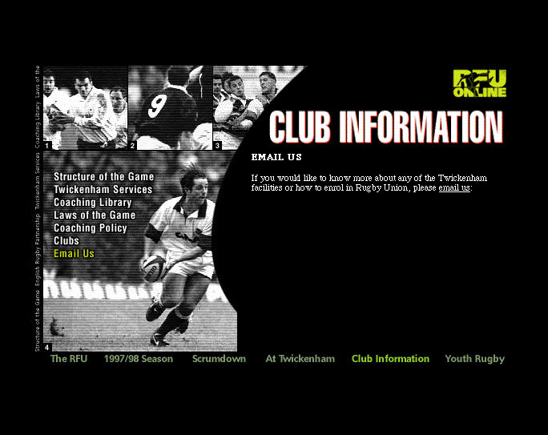
HCI 201 Multimedia and the www
winny

Slide 55
Black
HCI 201 Multimedia and the www
Black is associated with power, elegance, formality, death, evil, and mystery
Black is a mysterious color associated with fear and the unknown (black holes)
Black denotes strength and authority; it is considered to be a very formal, elegant, and prestigious color (black tie, black Mercedes)
Black contrasts well with bright colors. Combined with red or orange - other very powerful colors - black gives a very aggressive color scheme
winny

